Slide 1

Swan_soundbar_cable update request
SH,SON
ALT Co., Ltd.
Issued Date
2020.10.09
Ver.1.0

Slide 2
1. Add the bushing : Side LED Cable
This is easy to assembly way,
  the cable is assembled with the bushing installed by cable vender
  This is a familiar specification to sound component vender.
  Speaker cable vender is preparing with the same specifications.
Please request 8P cable vender below specification (see next page)
2

Slide 3
1. Add the bushing : Side LED Cable
R side LED cable
L side LED cable
Side LED PCBA
4CM
Front LED PCBA
26CM
Bushing out side
Bushing inner side
Side LED PCBA
7.5cm
Front LED PCBA
26CM
Bushing out side
Bushing inner side
3

Slide 4
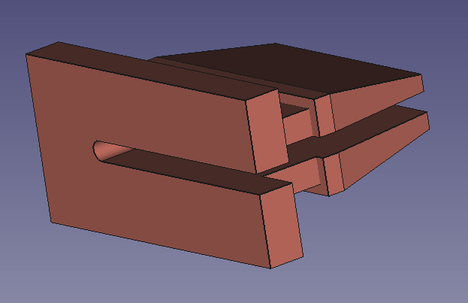
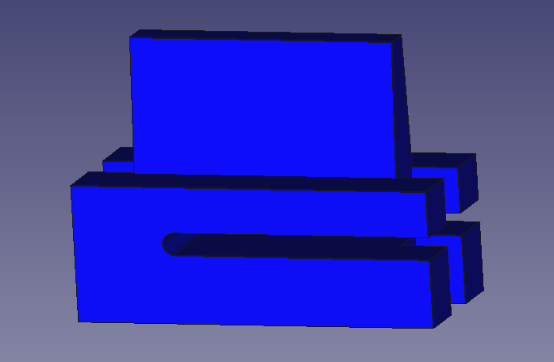
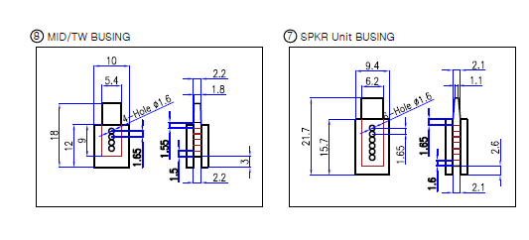
1. Add the bushing : Side LED Cable
Bushing image
  Out side / Inner side
Just reference : speaker cable bushing
4

Slide 5

1. Add the bushing : Side LED Cable
Bushing technical information
  Material : TPE or NRB
  Hardness : 50
  Color : don’t care. Black color is preferred
3D drawings
  Attached
5

Slide 6
2. Sponge wrapping
All cables inside the soundbar should be wrapped with a sponge. Due to prevent vibration and noise
In mockup, ALT & Inkel was made debugging of vibration and noise.
  As a result, need all cables inside should be wrapped with a sponge
Request cable list
  8P cables
    SoC to LED board
    LED board to Side LED board
  10P cables
    SoC to MIC board
    SoC To Button board
  Power cable
6

Slide 7
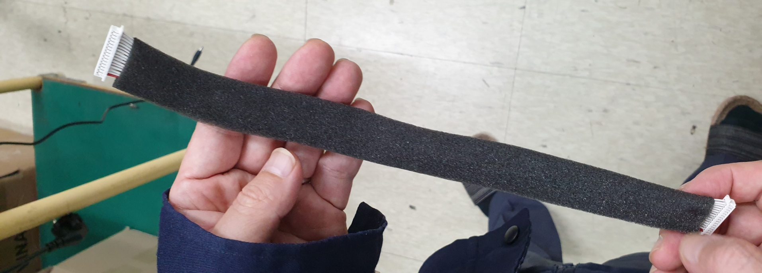
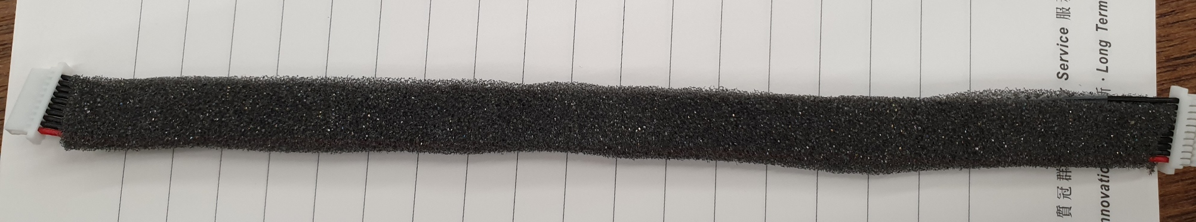
2. Sponge wrapping
technical information
  Material : Sponge
  Hardness :
  Color : don’t care. Black color is preferred
Reference image
7

Slide 8
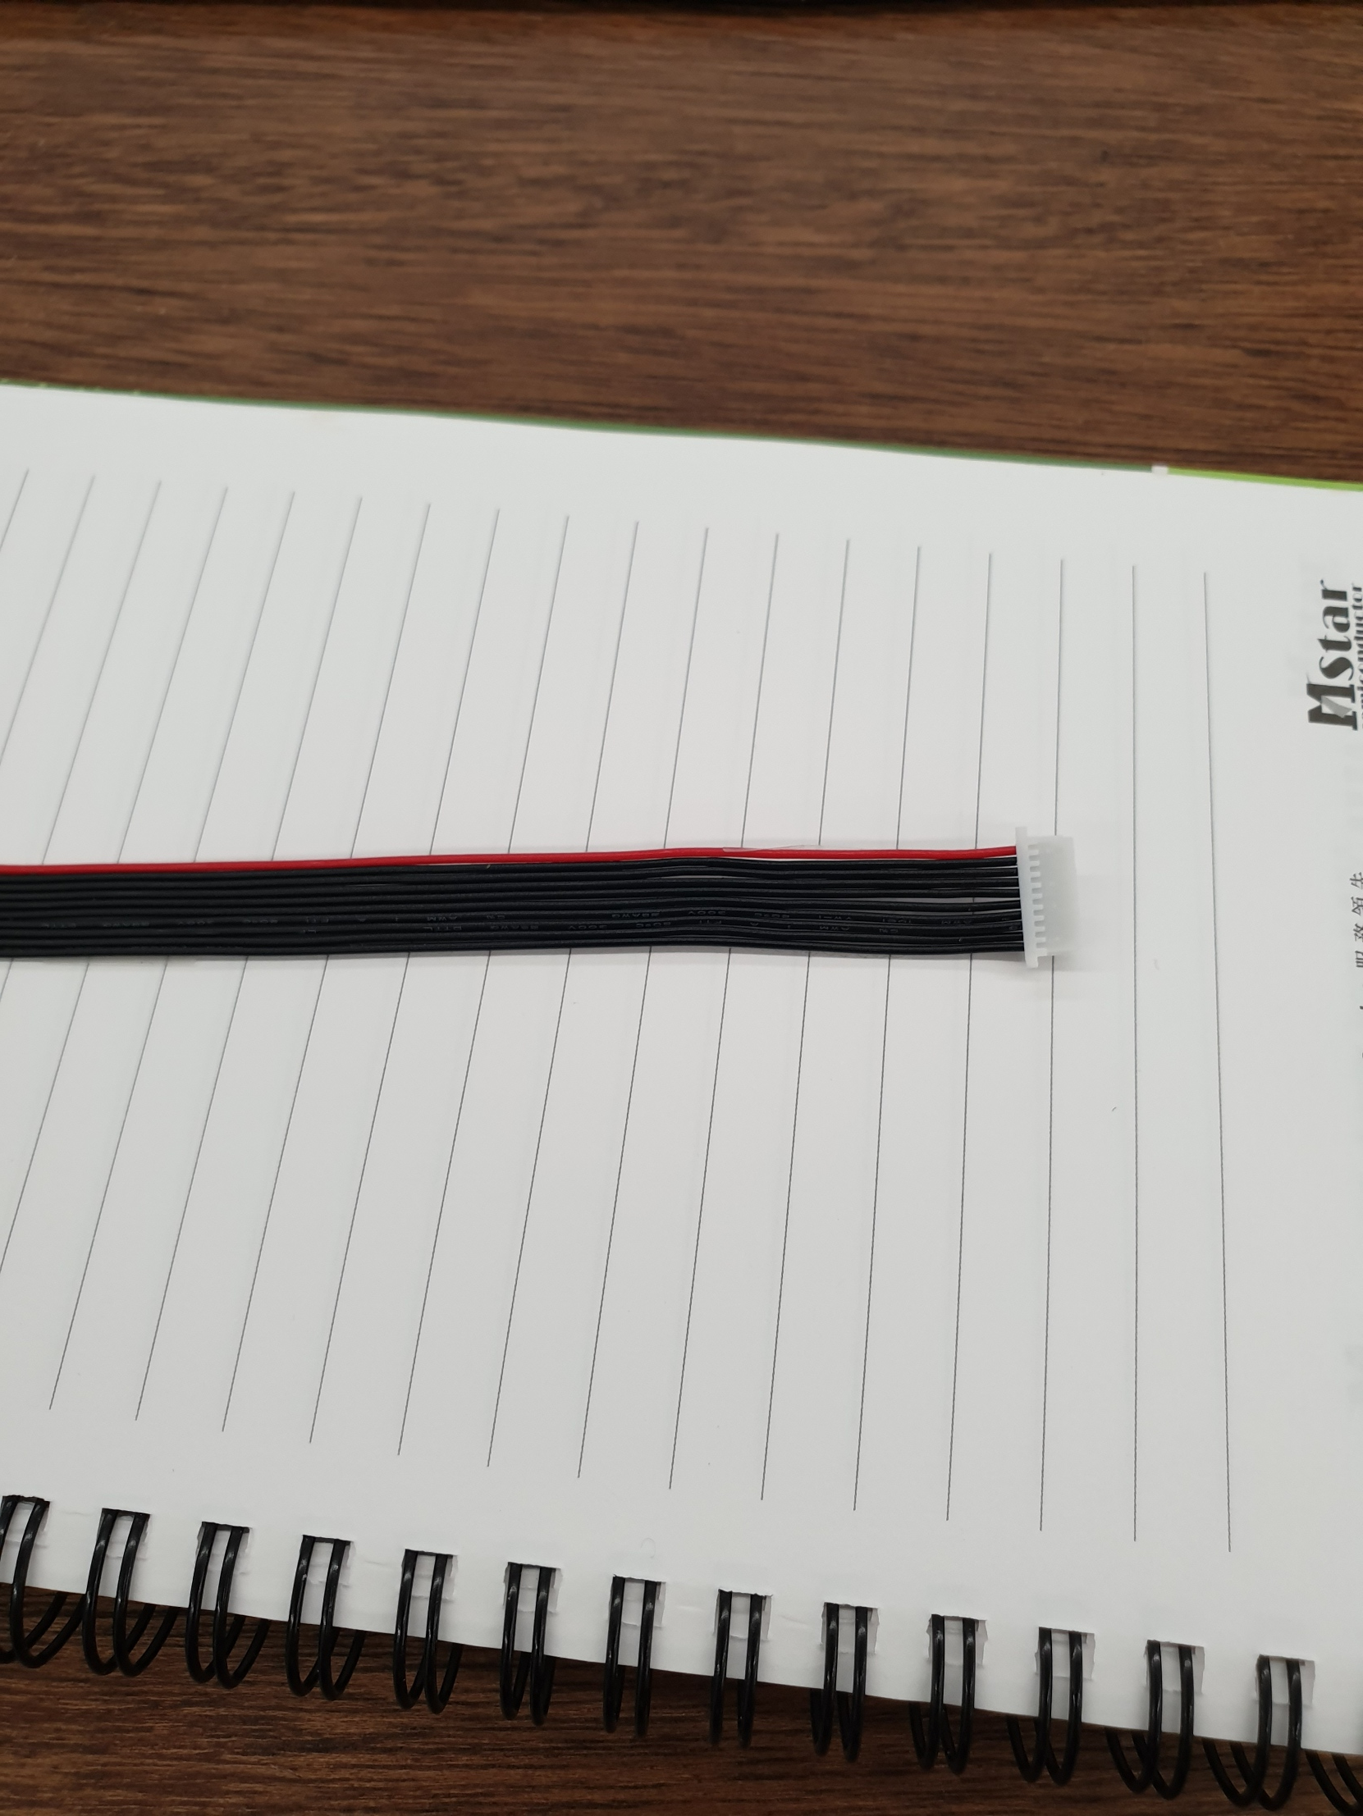
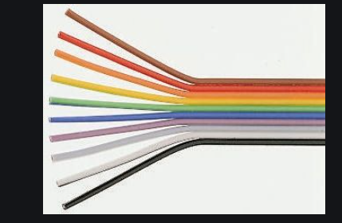
3. Plat cable suggestions
This is easy to assembly way,
  If the cable assembly was a separated wire, It may be damaged during assembly.
Change suggestion cable list
  8P and 10P cable
Reference image
8

